Slide 1
ORM Consistency and data retention over time
Amit Ganon

Slide 2
What is ORM?
ORM, or Object-Relational Mapping, is a programming technique that allows developers to map data from a relational database to an object-oriented programming language. This allows developers to interact with the database using an object-oriented paradigm, which can make it easier to develop and maintain applications.
In general, ORM frameworks provide a set of tools and libraries that automate the mapping between the database and the object-oriented programming language. This includes mapping tables and columns to classes and attributes, as well as providing tools for querying and manipulating data in the database.
In the context of Java, there are several popular ORM frameworks available, including Hibernate, EclipseLink, and MyBatis. These frameworks provide a standardized way of working with databases in Java

Slide 3
Hibernate:
Hibernate, is a widely used Java ORM framework that provides a rich set of features for working with databases, including support for a wide range of database systems, caching, and transaction management. Hibernate uses an XML configuration file or annotations to map database tables and columns to Java classes and attributes.

Slide 4
Key features of Hibernte
01
02
03
Querying:
Object-relational mapping:
Automatic persistence:
Hibernate provides a powerful querying language called Hibernate Query Language (HQL), which is similar to SQL but operates on objects instead of tables. HQL can be used to write complex queries that span multiple tables, and supports features such as joins, subqueries, and projections.
Hibernate provides a transparent layer between the application and the database, allowing developers to work with databases in an object-oriented way. This makes it easier to write code that is more maintainable and easier to understand
Hibernate provides automatic persistence of objects, meaning that changes to objects are automatically propagated to the database. This makes it easier to manage data consistency, and reduces the amount of boilerplate code that developers need to write.

Slide 5
Key features of Hibernte
04
05
Caching:
Transaction management:
Hibernate provides a range of caching options, including first-level and second-level caching. First-level caching caches objects within a single session, while second-level caching caches objects across multiple sessions. This can help improve performance by reducing the number of database queries that need to be executed.
Hibernate provides transaction management, which ensures that database updates are performed atomically and consistently. This helps to prevent data inconsistencies and ensure data integrity.

Slide 6
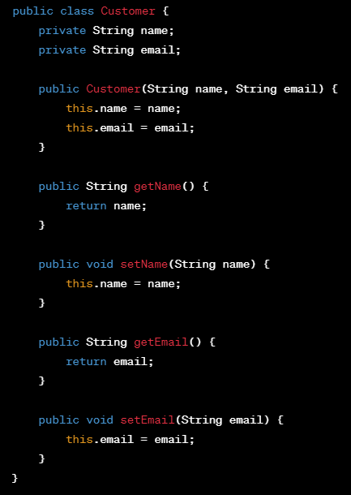
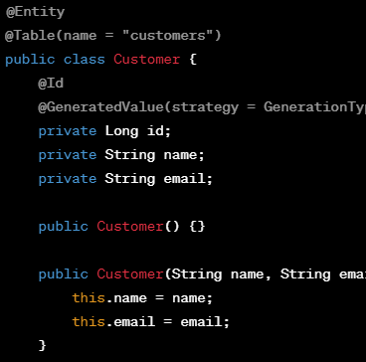
Example
The @Entity annotation in Hibernate is used to indicate that a class is an entity, i.e., it represents a table in a relational database.
The @Id annotation marks the id field as the primary key
@GeneratedValue annotation specifies that the value for the primary key will be generated automatically by the database system.

Slide 7
Transaction support
Hibernate supports transactions, which are fundamental to implementing a database system. Transactions allow a sequence of database operations to be treated as a single, atomic unit of work. In other words, a transaction ensures that all operations within the transaction are either committed or rolled back as a single operation.

Slide 8
The library works for situations of incompatibility
Coping with the hierarchy of classes:
Coping with the context of objects:
Hibernate supports inheritance and polymorphism in object-oriented programming. It can handle complex class hierarchies by mapping them to database tables using inheritance strategies. Hibernate provides different inheritance strategies that help in handling complex class hierarchies, such as single table, joined table, and table per class hierarchy.
Hibernate uses the concept of a session to maintain the relationship of an object with its environment. A session is a context in which objects are loaded, saved, updated, and deleted. Hibernate manages the state of an object and tracks any changes made to it during a session. Hibernate supports transaction management, which provides a mechanism for grouping a set of database operations into a single unit of work. Hibernate provides APIs for creating, committing, and rolling back transactions.

Slide 9
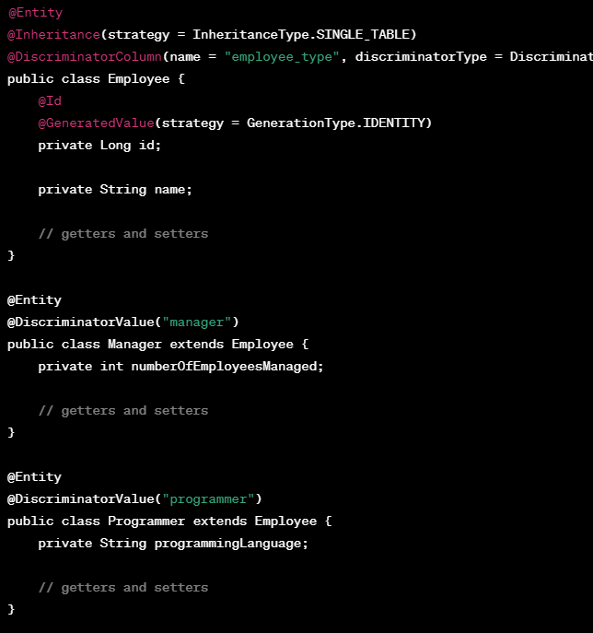
Example
Let's say we have a class hierarchy for a system that manages employees in a company. The hierarchy looks like this:
Employee (base class)
Manager (subclass of Employee)
Programmer (subclass of Employee)

Slide 10
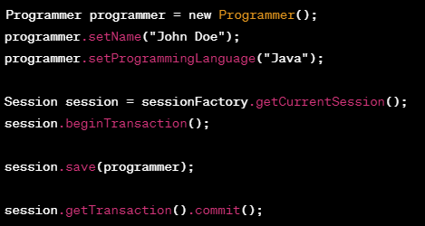
Adding a programer
In this example, we're using a single table inheritance strategy, which means that all the subclasses are mapped to the same table as the base class. We're also using a discriminator column to identify the subclass for each row in the table.

Slide 11
Thanks for listening

